Slide 1
SAP BTP RAP Training
Day 23
Anubhav Oberoy
www.AnubhavTrainings.com
Follow excellence with sheer passion

Slide 2


DISCLAIMER
The training content and delivery of this presentation is confidential, and cannot be recorded, or copied and distributed to any third party, without the written consent of Anubhav Trainings

Slide 3
Agenda – Day 23
01
Early Numbering
02
Feature Control
03
Early Numbering

Slide 4

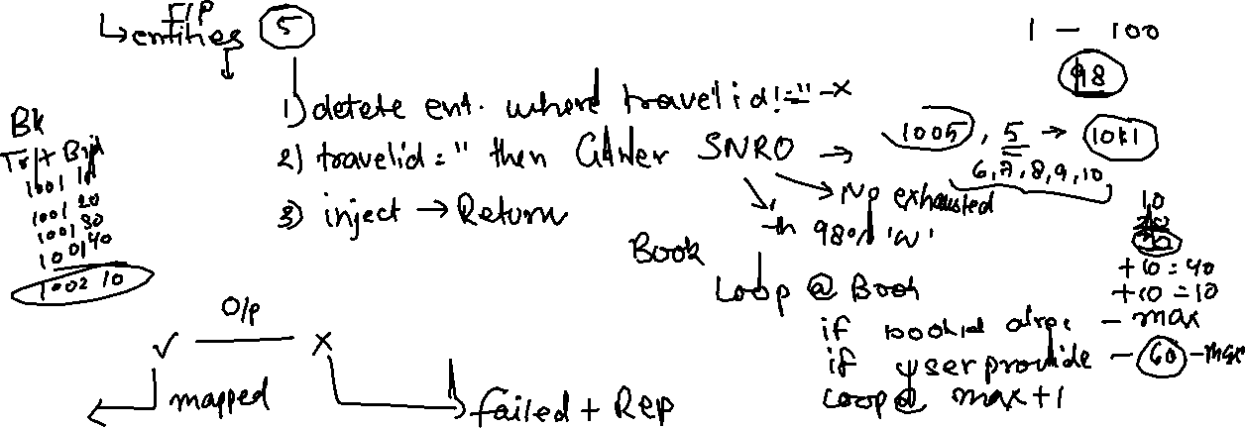
BO instance features
Early numbering
It allows a managed numbering for bo instances during creation process. Like in ABAP we use sequence numbers (SNRO) to auto generate primary keys, here in RAP we can use early numbering. It can be handled for all the entities. For this we need to implement the logic in RAP BIMP.
Every assigned key must be unique, otherwise the instances will be rejected by the database which will result to dump. We will be reusing a SNRO sequence already created by SAP in the system.
www.anubhavtrainings.com

Slide 5
Sequence of calls
Fiori app
OData
RAP
BIMP
HANADB
entities
FAILED, MAPPED, REPORTED
www.anubhavtrainings.com

Slide 6
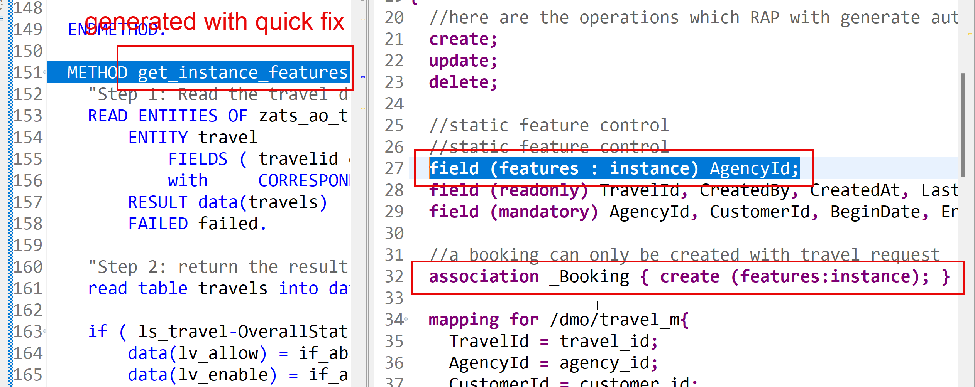
Feature Control
As an application developer we want to determine which entities of our BO needs to allow create-, update-, delete- operations. Apart from that which properties of BO are allowed to be mandatory, read only, creatable, updatable. We can also control the availability of our data actions.
In RAP, feature controls are of 2 types:
Static feature control – are specified at the level of behavior definition only. Statically declared and easy to implement.
Dynamic feature control – complex to implement for more complex requirements. They require a mandatory implementation in BIMP class. We use keyword features:instance
www.anubhavtrainings.com

Slide 7
Data Actions in RAP
In the context of RAP, an action is a non-standard operation that change the data of a BO instance or create new BO instances. They are self implemented operations. There are two main categories of data actions can be implemented in RAP:
Non factory action: Defines a RAP action which offers the non-standard behavior and implement custom logic in handler with MODIFY clause. A non factory action can be of 2 sub types (change a property of a record)
Static – they are not bound to any instance, they are generic and can be applied to all instances, like we want to change the booking fees for all travel request as fix price during promotion period.
Instance – An action that, by default relates to a BO RAP entity instance and changes the state of BO instance. E.g. like approve or reject a travel request where user choose a instance which they want to work with.
Factory Action – A factory action used to create new BO instances. A factory action can be instance-bound (default) or static.
Instance – that copy specific values of an instance and create new instances based on copied data
Static – can be used to create instances with prefilled default values
www.anubhavtrainings.com

Slide 8

Determination
A determination modifies instance of business object based on trigger condition. Trigger condition can be modify operations such as create, update, and delete and modified field. There are 2 types of determination
on modify – will be triggered before save whenever trigger condition is met e.g. when I change booking fee
on save – will always trigger at the time of save
Steps
Add the code for defining the determination in behavior definition, we want to do it in reusable way
Use quick fix to generate the code for determination
Define a structure where we can store all the booking fees and currency code
Read all travel instances, subsequent bookings using EML
Total all booking and supplement amounts which are in common currency
Delete the values w/o any currency
Loop at all amounts and compare with target currency
Perform currency conversion
Put back the total amount
Return the total amount in mapped so the RAP will modify this data to DB
www.anubhavtrainings.com

Slide 9

What We Did
Let’s Summarize

Slide 10

www.anubhavtrainings.com
Thank You
End of Day 15

Slide 11


We’re committed to empower you to be
#FutureReady
through powerful training solutions.
We build the workforce of the future.
260+
Corporate Clients
60,000+
Learners Trained
26000+
Learners Placed
FREE WEBINARS
Sign up for free webinars with industry experts every fortnight!
Enroll Now!
Contact us today!
https://anubhavtrainings.com

